Slide 1


ECTE 250
ENGINEERING DESIGN AND MANAGEMENT 2

Slide 2
ECTE 250
ENGINEERING DESIGN AND MANAGEMENT 2

Slide 3
PROPOSALS
GROUP E:
GANGA
JUNAID
YUSUF
EBRAHEIM

Slide 4
PROJECT PROPOSALS
GROUP E:
GANGA RAJ - 7354022
ODUOLA JUNAID - 7291401
YUSUF MAHER MAHMOOD - 7406368
EBRAHEIM PASHA - 7064779

Slide 5
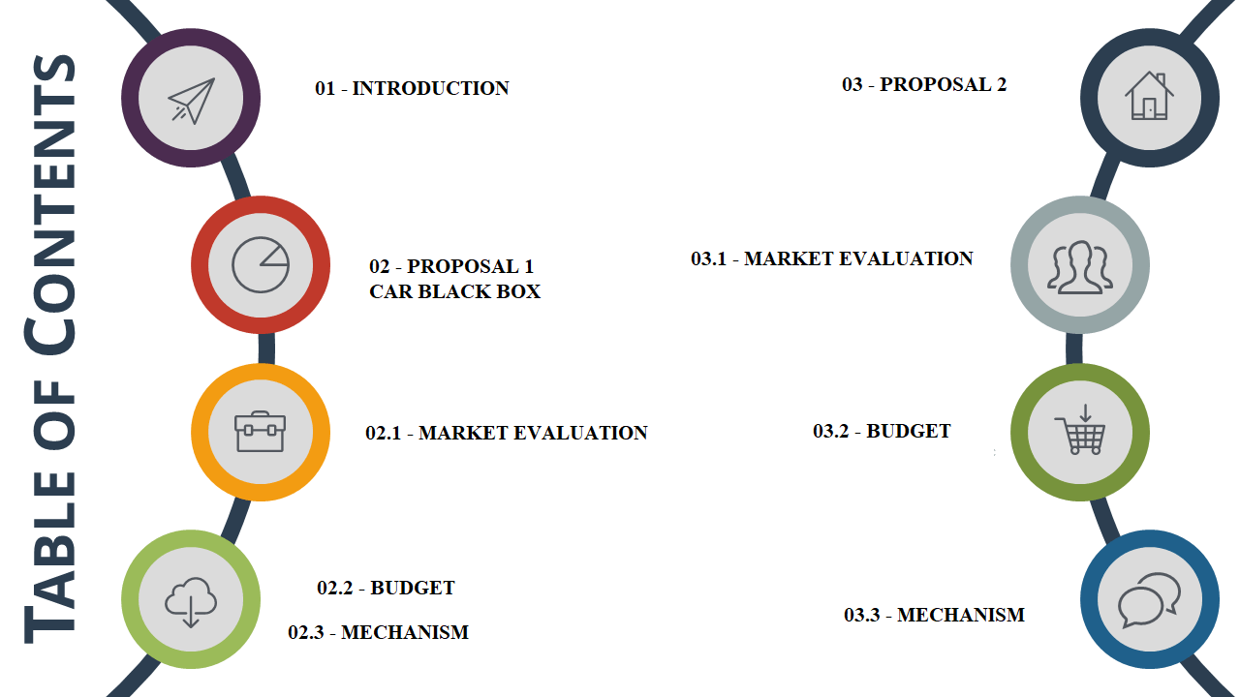

Slide 7
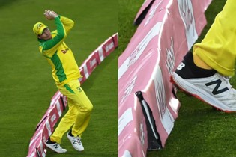
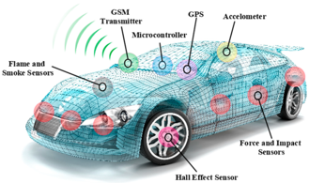
Why do we need this technology?
What’s the need of it for a common person?
Is it sense able and can be used in the market
The goal of our team is to assist humans in making games fair and clear on the field, as well as off the field on the roadways by assuring the driver's safety.
Our goal is to create a prototype of a touch detection system for cricket field boundaries as well as a Blackbox for a car.
INTRODUCTION

Slide 8

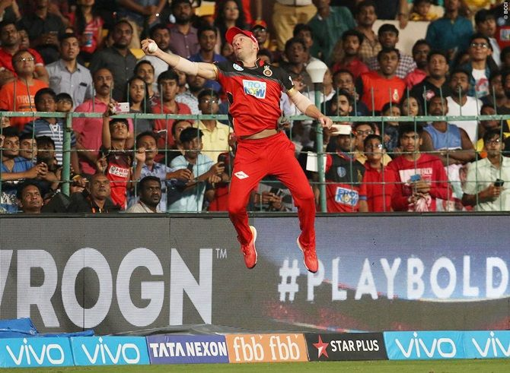
INTRODUCTION
Why do we need this technology?
What’s the need of it for a common person?
Is it sense able and can be used in the market
The goal of our team is to assist humans in making games fair and clear on the field, and off the field on the roadways by assuring the driver's safety.

Slide 9
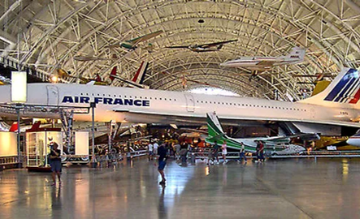
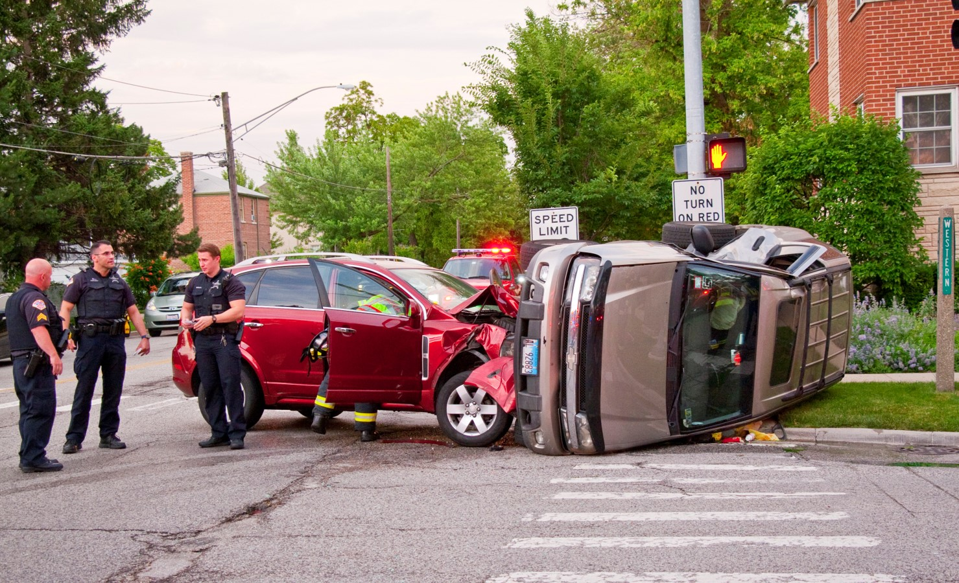
Proposal I Car Black Box

Slide 10
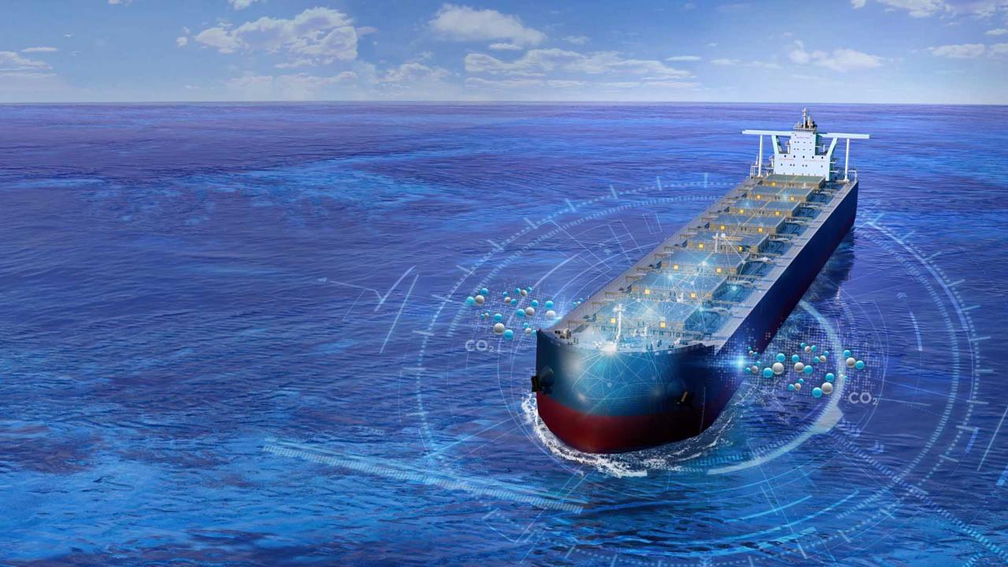
PROPOSAL I Car Black Box

Slide 11



MARKET PROSPECT
Car Black box in the market will help the city and the country to be safer and provide fast emergency services if needed.
It also help people trust that the authorities will take the right decision

Slide 12
MARKET PROSPECT
As there is not much of our idea in the world, we will be introducing how can it be introduced to todays market
We will be providing our idea to international insurance companies.
We chose international companies because it will help us to spread our idea to more than one place or country which will bring a big profit in return.
2. Going for the next step we will be going to the vehicle manufacture companies where our black box will be designed for the car I meant the company will start to introduce their car and the black box as one of their benefits.

Slide 13

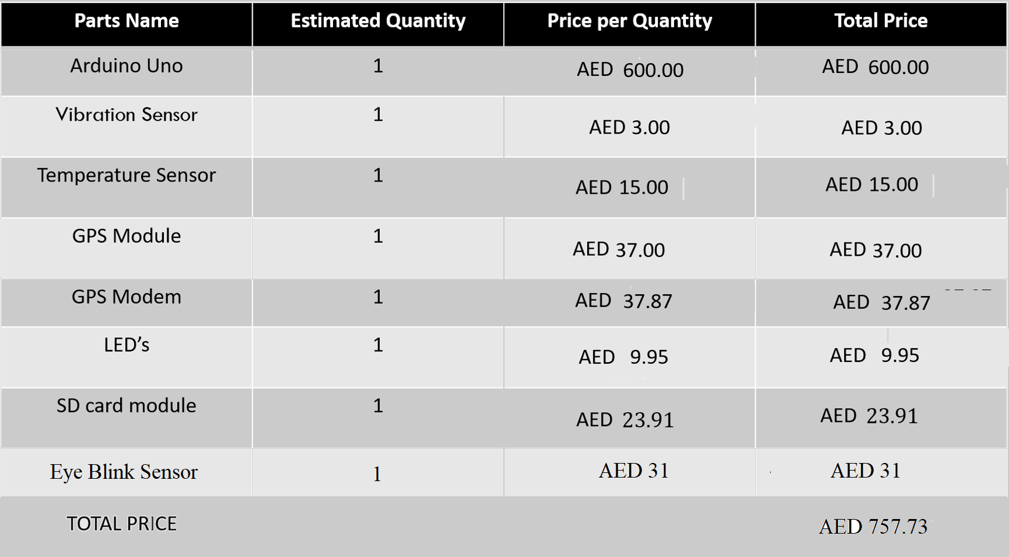
BUDGET

Slide 14
BUDGET

Slide 15
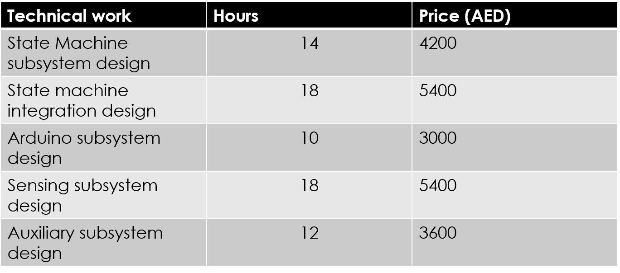
LABOUR COST:
▪ Labour cost is 300AED/hour. And 400AED/hour for consultation from Lab instructor.
▪ The estimated working hours on the technical parts as follows:
▪ The total price is: 21,600 AED.

Slide 16

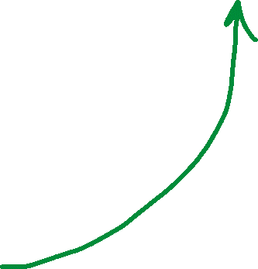

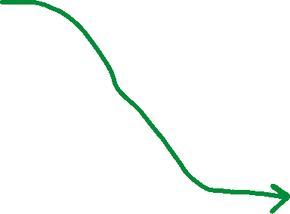



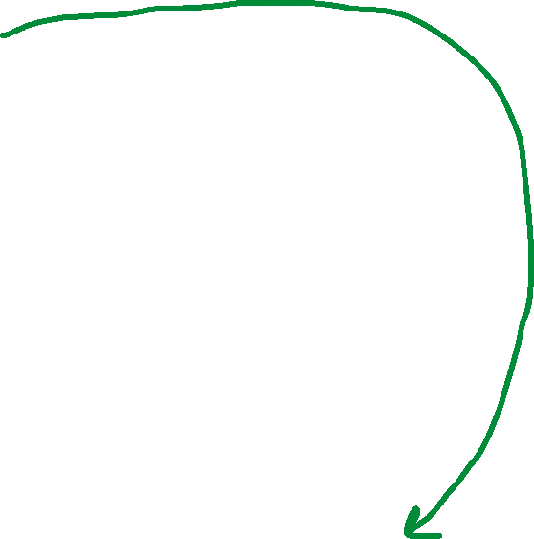

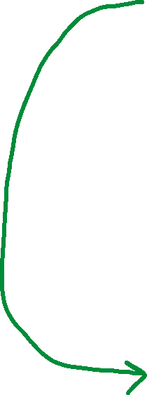
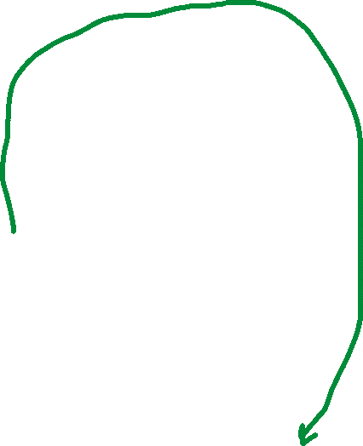

MECHANISM
NO SIGNS OF ACCIDENT
(000)
SIREN SOUNDS ACTIVATED
(011)
TEXT SENT TO DRIVER
(001)
TEXT SENT TO POLICE
(111)
Y=1
TEXT SENT TO EMERGENCY CONTACT
(010)
MEMORY STORED
(101)
STATE DIAGRAM

Slide 17
MECHANISM
NO SIGNS OF ACCIDENT
(000)
SIREN SOUNDS ACTIVATED
(011)
TEXT SENT TO DRIVER
(001)
TEXT SENT TO POLICE
(111)
Y=1
TEXT SENT TO EMERGENCY CONTACT
(010)
MEMORY STORED
(101)
STATE DIAGRAM

Slide 18
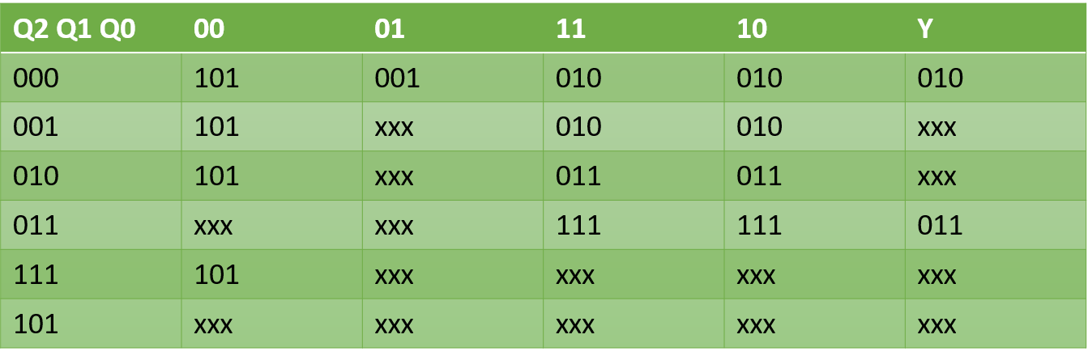
-------------------------------- AB--------------------------------
STATE DIAGRAM

Slide 19
STATE DIAGRAM
-------------------------------- AB--------------------------------

Slide 20
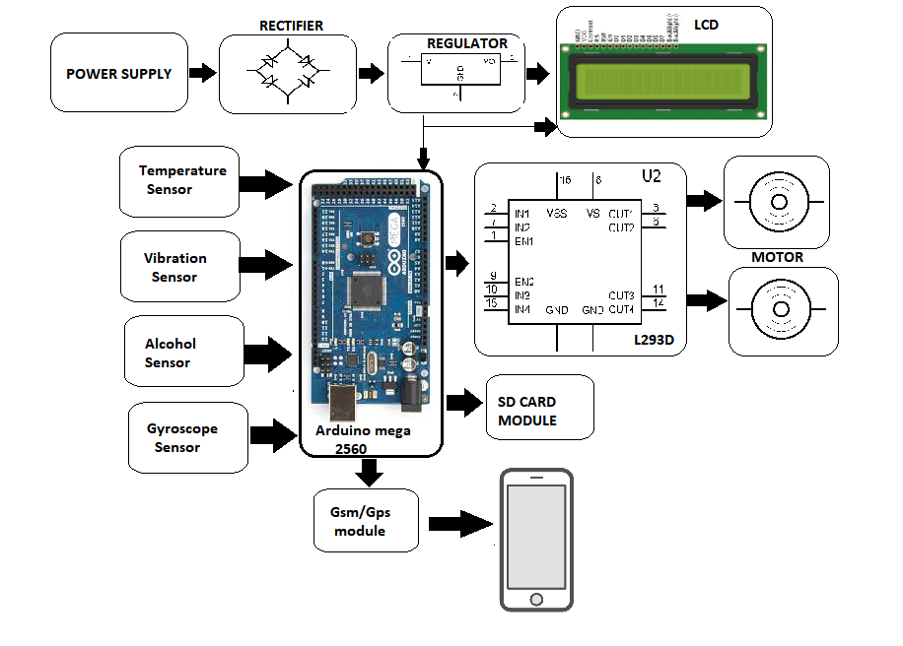
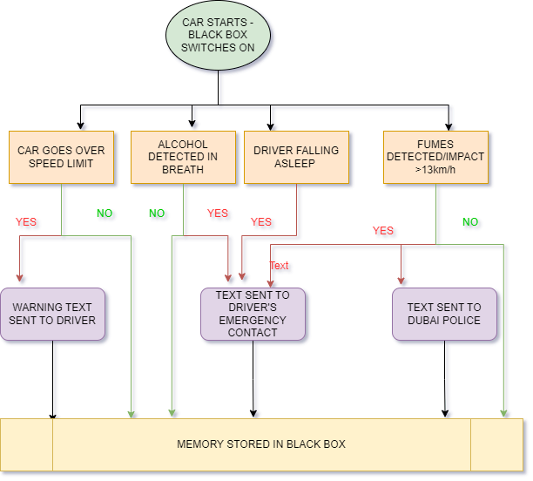
Block Diagram
Flow Diagram

Slide 21
Block Diagram
Flow Diagram

Slide 22
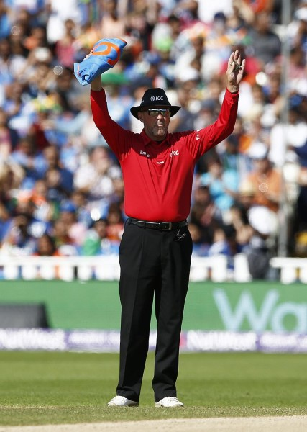
Proposal 2 Touch Sensor and speed monitor for Cricket boundaries

Slide 23
PROPOSAL 2 Touch Sensor and speed monitor for Cricket boundaries

Slide 24
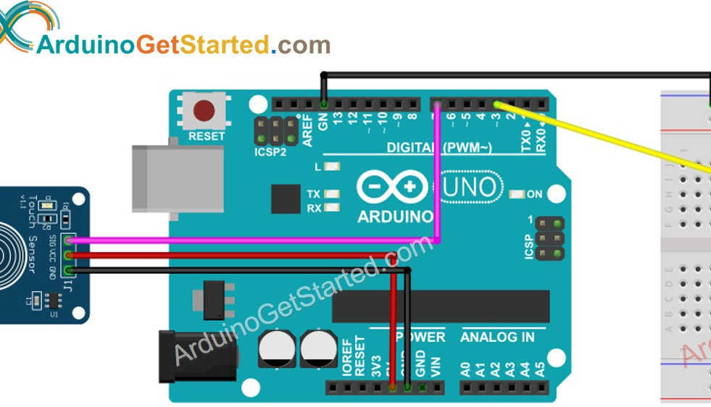
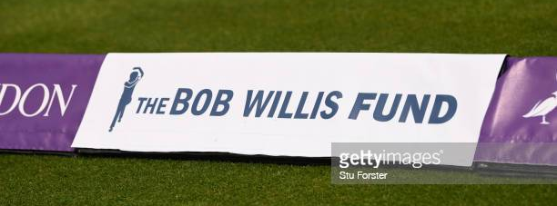
Touch sensor, speed sensor fixed inside of the boundary line.
To make game fair
Close call Catches, sixes and fours can be monitored.
Helps the umpire to give decision quickly and resume the game

Slide 25
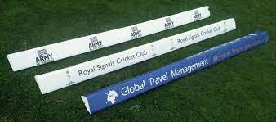
Touch sensor, speed sensor fixed inside of the boundary line.
To make game fair
Close call Catches, sixes and fours can be monitored.
Helps the umpire to give decision quickly and resume the game

Slide 26
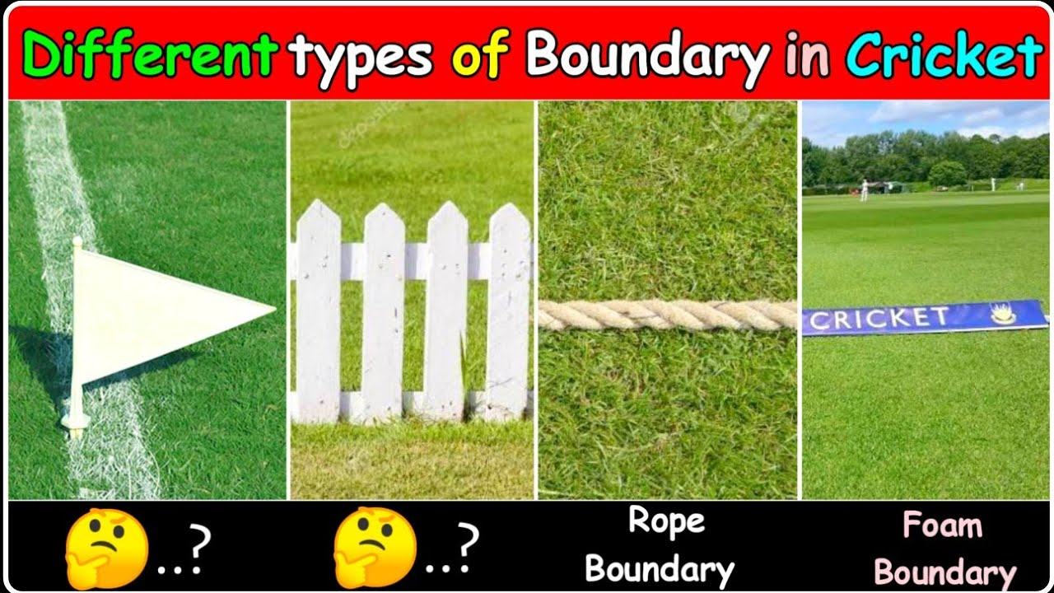
MARKET PROSPECT
It will Be a fare play for both the team .
Close Call Catches or close sixes can be monitored.

Slide 27
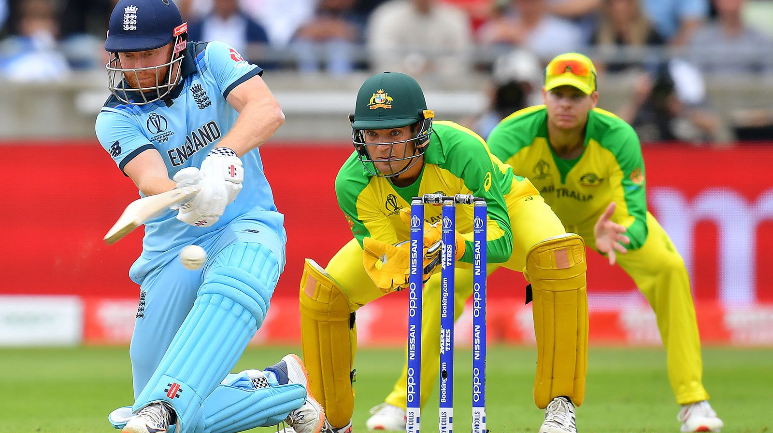
MARKET PROSPECT
We will be installing this system at first on small leagues for cricket and then we will install all in the final games.
2. Big Leagues will definitely take the system as will have a fair play for both the team.
3. And at the end will and most important it will increase the sell’s because it will be more profitable as instead of getting 3 or 4 people to keep on looking there will need only two or even less.

Slide 28
Parts Name | Estimated Quantity | Price per Quantity | Total Price
Arduino Uno | 1 | AED 600.00 | AED 600.00
Vibration Sensor | 1 | AED 3.00 | AED 3.00
GPS Module | 1 | AED 37.00 | AED 37.00
GPS Modem | 1 | AED 37.87 | AED 37.87
TOTAL PRICE |  |  | AED 677.87
BUDGET

Slide 29
BUDGET
Parts Name | Estimated Quantity | Price per Quantity | Total Price
Arduino Uno | 1 | AED 600.00 | AED 600.00
Vibration Sensor | 1 | AED 3.00 | AED 3.00
GPS Module | 1 | AED 37.00 | AED 37.00
GPS Modem | 1 | AED 37.87 | AED 37.87
TOTAL PRICE |  |  | AED 677.87

Slide 30
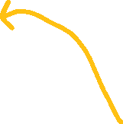



TOUCH BY PLAYER/BALL
VIDEO RECORDING AND OTHER DATA SENT
(1X)
LIGHTS OFF
(00)
TOUCH SENSED – LIGHTS ON
(01)
NO TOUCH
MECHANISM
NO TOUCH
STATE DIAGRAM

Slide 31
MECHANISM
TOUCH BY PLAYER/BALL
LIGHTS OFF
(00)
TOUCH SENSED – LIGHTS ON
(01)
NO TOUCH
VIDEO RECORDING AND OTHER DATA SENT
(1X)
NO TOUCH
STATE DIAGRAM

Slide 32
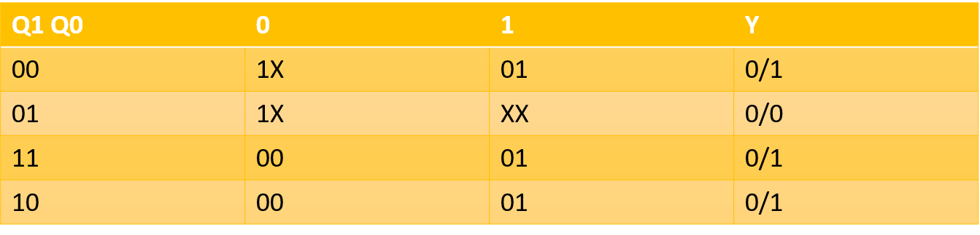
--------------------------- A---------------------------
STATE TABLE
DERIVED EQUATIONS:
Q0* = A
Q1*= Q1'.A'
Y= Q0'.A + Q1.A

Slide 33
STATE TABLE
--------------------------- A---------------------------
DERIVED EQUATIONS:
Q0* = A
Q1*= Q1'.A'
Y= Q0'.A + Q1.A

Slide 34
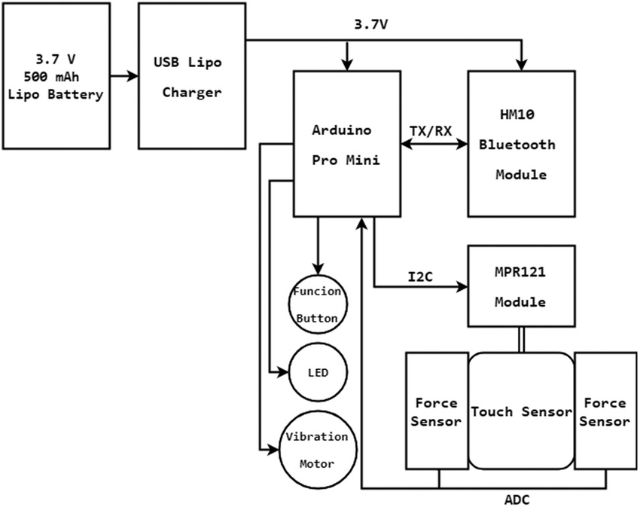
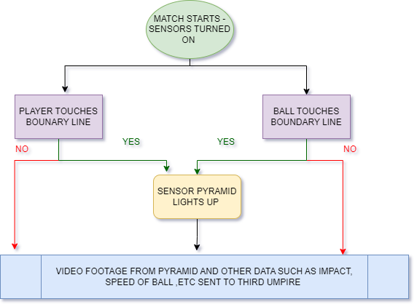
Block diagram
FLOW DIAGRAM

Slide 35
Block diagram
FLOW DIAGRAM

Slide 36


QUESTIONS
THANK YOU

Slide 37
QUESTIONS
THANK YOU

